Slide 1
Boussinesq eq. θ and h comparison

Slide 2
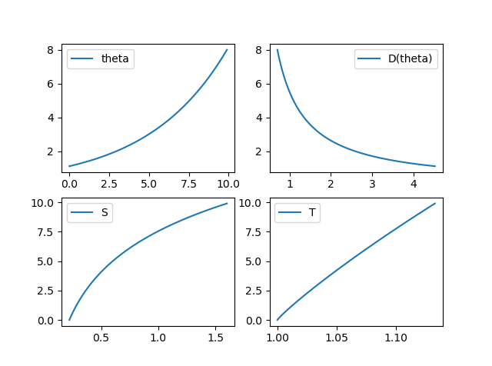
Strategy
Param | value
s0 | 0.1
s1 | 0.2
t0 | 1
t1 | 0.01
t2 | 1.1
Pick θ(h) = exp(s0 + s1*h)
S(h) = dθ/dh = s1* θ(h)
Pick T(h) = t0 + exp(t1*h^t2)
Compute D(θ)
Fix parameters: s_{i}, t_{i}
Solve Boussinesq eq. in FiPy in 3 different ways:
Old h version without ImplicitSource
New h version with ImplicitSource
θ version

Slide 3
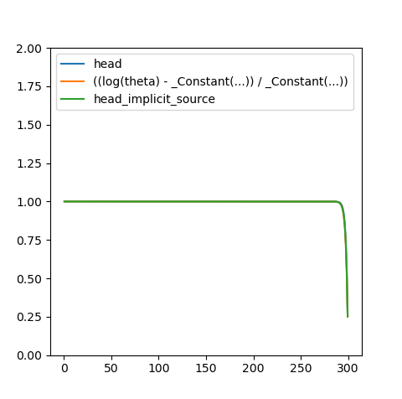
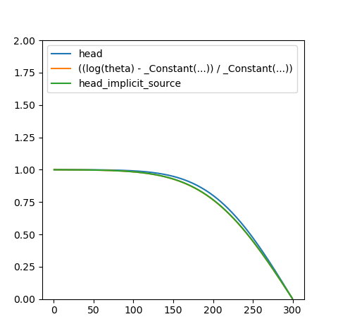
dt = 1 ; 100 timesteps
Initial
Final
x
x
L2 norm final sol | h | h_implicit_source | theta
h | 0 | 0.19 | 7.45
h_implicit_source |  | 0 | 7.34
theta |  |  | 0

Slide 4

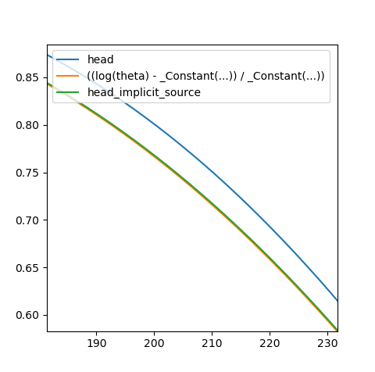
dt = 10 ; 100 timesteps
Final
Final zoom
x
x
L2 norm final sol | h | h_implicit_source | theta
h | 0 | 0.34 | 9.54
h_implicit_source |  | 0 | 9.81
theta |  |  | 0

Slide 5
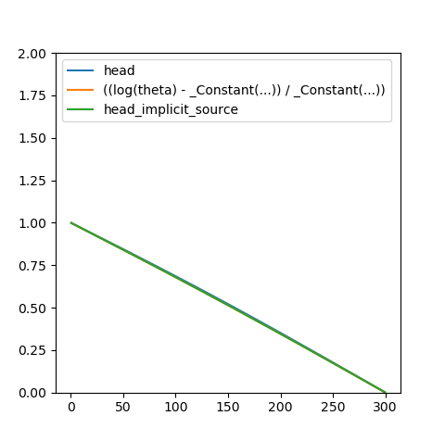
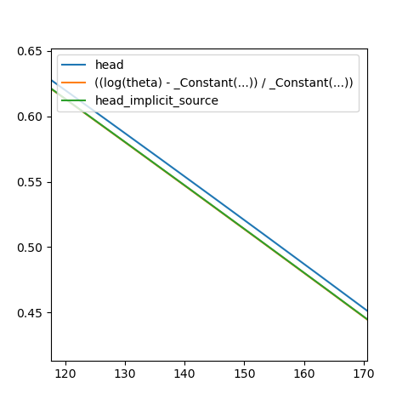
dt = 100 ; 100 timesteps
Final
Final zoom
x
x
L2 norm final sol | h | h_implicit_source | theta
h | 0 | 0.06 | 12.96
h_implicit_source |  | 0 | 13.01
theta |  |  | 0

